Slide 1
Regression Analysis
Multiple Linear Regression
Nicoleta Serban, Ph.D.
Professor
School of Industrial and Systems Engineering
Estimating Regression Line & Predicting a New Response: Data Example

Slide 2

About This Lesson

Slide 3

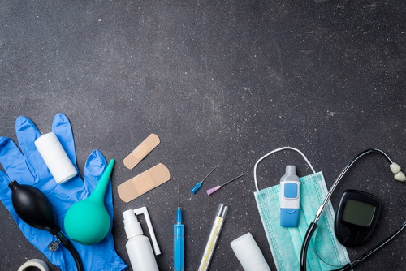
Linear Regression: Example 1
Quantitative Predicting Variables:
X₁ = amount (in hundreds of dollars) spent on advertising in 1999
X₂ = total amount of bonuses paid in 1999
X₃ = market share in each territory
X₄ = largest competitor's sales (thousands)
Qualitative Predicting Variable:
X₅ = indicates region where office is located (1 = south, 2 = west, 3 = midwest)
Response Variable:
Y = yearly sales (in thousands of dollars)
Sales
Advertisement

Slide 4
Example 1: Mean Response & Prediction
For all offices with the characteristics such as those of the first office:
  What is the average estimated sales?
  What is the standard deviation?
  What is the 95% confidence interval for this mean response?
If the first office’s largest competitor’s sales increase to $303,000 (assuming everything else fixed):
  What sales would you predict for the first office?
  What is its standard deviation?
  What is the 95% prediction interval for this prediction?

Slide 5
Example 1: Mean Response Estimation
s2 = summary(model)$sigma^2 # Variance estimate
X = model.matrix(model) # Design Matrix
xstar = X[1,] # First office data for formula
resp.var = s2*(xstar%*%solve(t(X)%*%X)%*%xstar) # Variance formula
sqrt(resp.var)
[,1]
[1,] 33.19118
newdata = meddcor[1,-1] # First office data for confidence interval
predict(model, newdata, interval="confidence") # Confidence Interval
fit lwr upr
1 934.7767 865.0446 1004.509

Slide 6

Example 1: Mean Response Estimation
a. Average estimated sales (mean response for sales):
$$\hat{y}=\text{934.7}\text{77}$$
Estimated standard deviation:
se($\hat{y}$)$=\text{33.191}$
95% Confidence Interval:
(865.045, 1004.509)
Interpretation: For offices with the same characteristics as the first, the average estimated sales are $934,777, with a lower bound of $865,045 and an upper bound of $1,004,509.
s2 = summary(model)$sigma^2 # Variance estimate
X = model.matrix(model) # Design Matrix
xstar = X[1,] # First office data for formula
resp.var = s2*(xstar%*%solve(t(X)%*%X)%*%xstar) # Variance formula
sqrt(resp.var)
[,1]
[1,] 33.19118
newdata = meddcor[1,-1] # First office data for confidence interval
predict(model, newdata, interval="confidence") # Confidence Interval
fit lwr upr
1 934.7767 865.0446 1004.509

Slide 7
Example 1: Mean Response Estimation
## Change the competitor's sales for prediction of future observation
xstar.new = xstar
xstar.new[5] = 303
# Variance formula
pred.var = s2*(1+xstar.new%*%solve(t(X)%*%X)%*%xstar.new) sqrt(pred.var)
[,1]
[1,] 64.31099
# Prediction Interval
predict(model, xstar.new[-1], interval="prediction")
fit lwr upr
1 911.0569 775.9446 1046.169

Slide 8
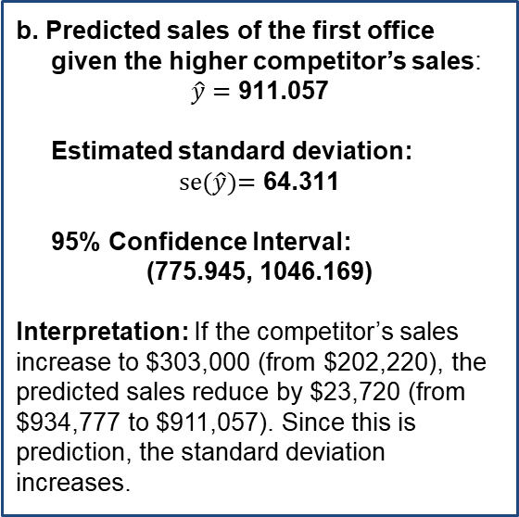
Example 1: Mean Response Estimation
## Change the competitor's sales for prediction of future observation
xstar.new = xstar
xstar.new[5] = 303
# Variance formula
pred.var = s2*(1+xstar.new%*%solve(t(X)%*%X)%*%xstar.new) sqrt(pred.var)
[,1]
[1,] 64.31099
# Prediction Interval
predict(model, xstar.new[-1], interval="prediction")
fit lwr upr
1 911.0569 775.9446 1046.169
b. Predicted sales of the first office given the higher competitor’s sales:
$$\hat{y}=\text{911.0}\text{57}$$
Estimated standard deviation:
se($\hat{y}$)$=\text{6}\text{4}\text{.}\text{31}$1
95% Confidence Interval:
(775.945, 1046.169)
Interpretation: If the competitor’s sales increase to $303,000 (from $202,220), the predicted sales reduce by $23,720 (from $934,777 to $911,057). Since this is prediction, the standard deviation increases.

Slide 9

Summary

